Slide 1

Project Management & Agile
DATA ANALYTICS | IRONHACK
Notes:
Sofia PM at ironhack
YES, you will have the slides to this presentation .

Slide 2



IRONHACK BOOTCAMP
Agenda
Project Management
Why agile?
Agile Values
Agile Principles
Kanban
Credit: Unsplash

Slide 3

Project Management

Slide 4
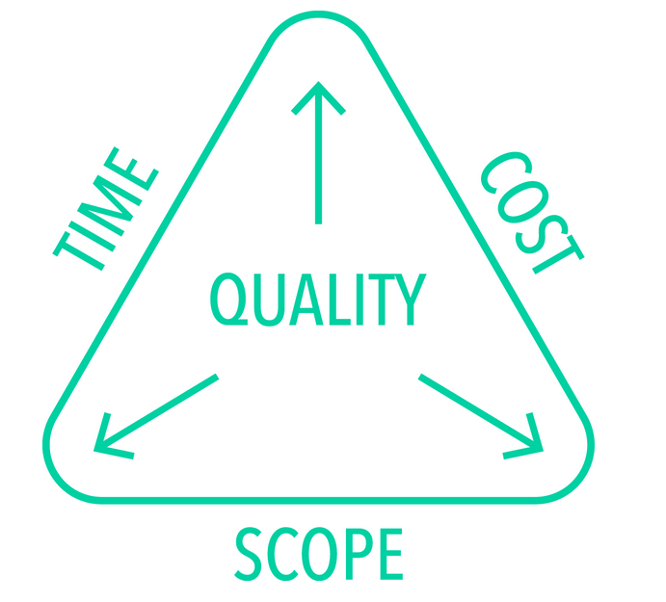
IRONHACK BOOTCAMP
Project Management Triangle
The quality of work is constrained by the project’s budget (cost), deadlines (time) and scope (features).
The project manager can trade between these constraints.
Changes in one constraint demand changes in others to compensate or quality will suffer.

Slide 5
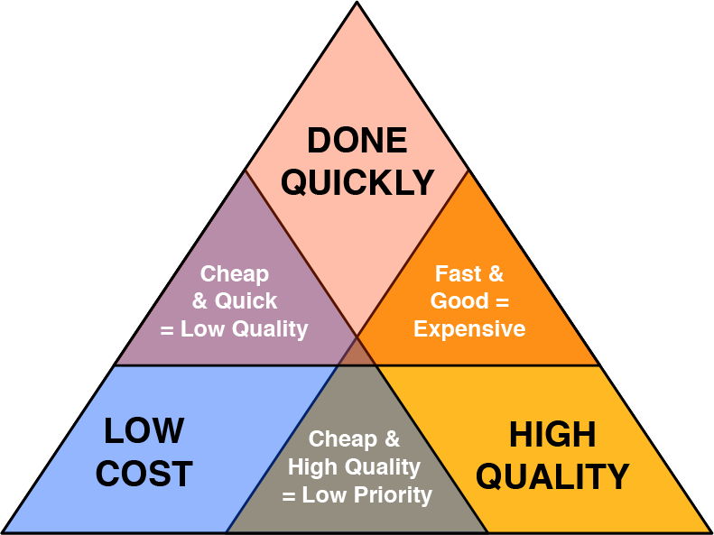
IRONHACK BOOTCAMP
Notes:
This is something that we CAN and SHOULD make transparent Also rise the possible RISKS of any different solution

Slide 6
Why Agile?

Slide 7

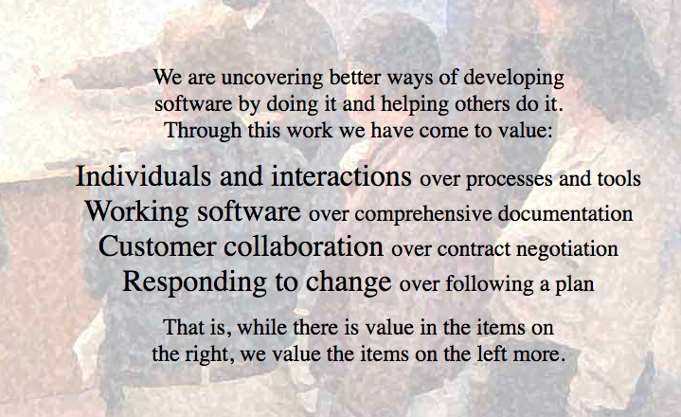
Agile is a response to unpredictability through incremental, iterative work, rescoping and feedback
Credit: Agile Manifesto
Notes:
WE The MAKERS
BOTTOM UP . Let us define the processes that make sense for this technology. We know the technology.

Slide 8
Agile Principles

Slide 9


Are you solving your team and users needs?
That’s what means progress and nothing else.

Slide 10
M O N T H L Y G L O B A L
Agile Principles
Early and continuous delivery of value (Sprints)
Welcome changing requirements, even late in the process.
Preference to the shorter timelines on projects
Cross-functional teams (Squads)
Build projects around motivated individuals.
The most efficient and effective method of conveying information is face-to-face conversation.
work-done is the primary measure of progress.
Notes:
Make relationship with them in the final project

Slide 11

Planning is Adaptive
When reality disagrees with the plans, change the plans!

Slide 12
M O N T H L Y G L O B A L
Agile Principles
Agile processes promote sustainable work
Continuous attention to technical excellence enhances agility.
Simplicity is essential.
Self-organizing teams.
Reflects on how to become more effective.

Slide 13
Agile Values

Slide 14

COMMITMENT
Notes:
commit to collaborate, to work with quality, to learn and improve constantly - note this value it is about the dedication and the effort, not about the final result

Slide 15

FOCUS
Notes:
focus on the work at hand versus on plans for an uncertain future and focus on what really matters to deliver finished work versus the accessory and questionable details

Slide 16

OPENNESS
Notes:
open to collaborate, to criticism, to trying different ideas and approaches especially when they challenge our way of thinking

Slide 17

RESPECT
Notes:
for others, their opinions, their context, skills and background, as well as for stakeholders and users alike

Slide 18
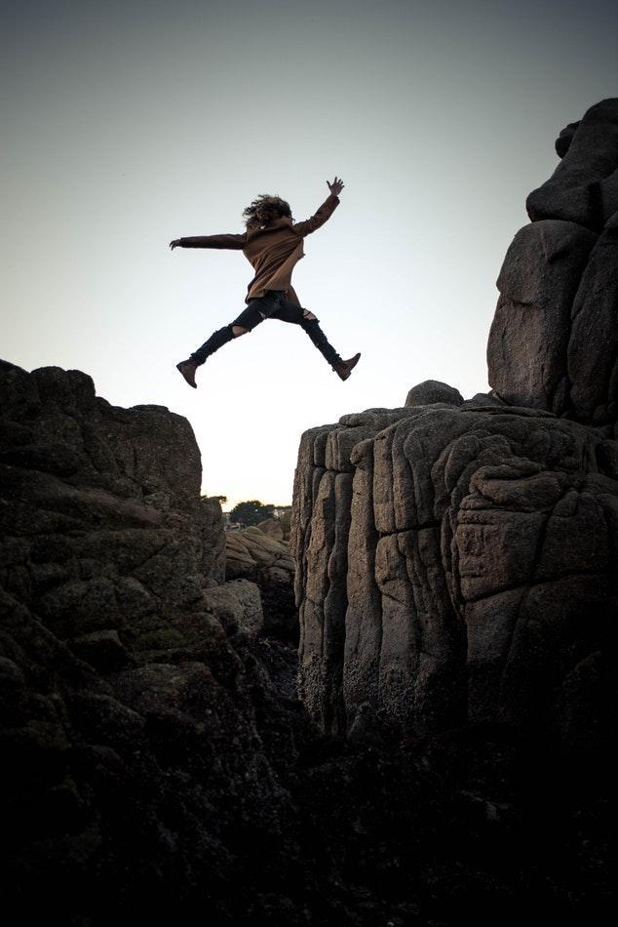
COURAGE
Notes:
to be open and transparent about our work and our progress, to accept changes in direction or ways of working, to finish what we start, to share risks and benefits, to challenge others and to respectfully speak the truth

Slide 19
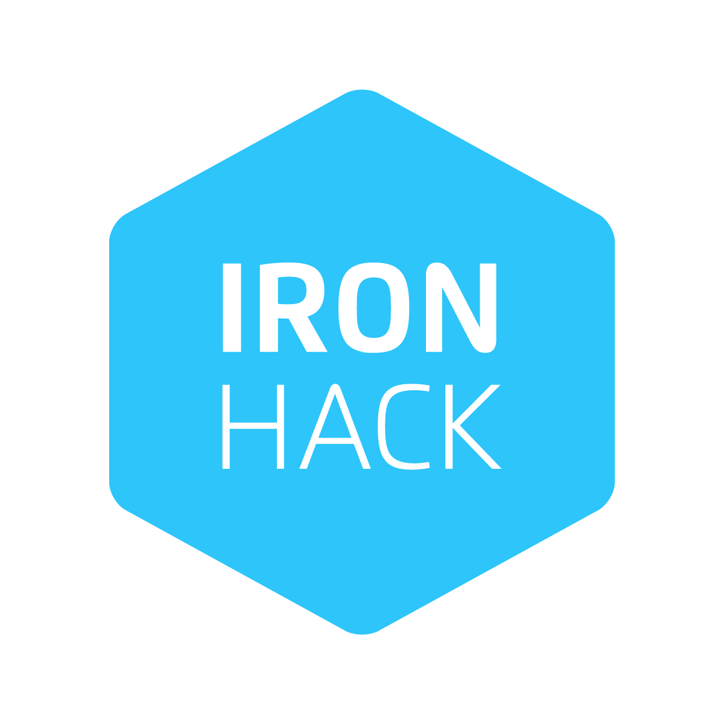
Kanban

Slide 20
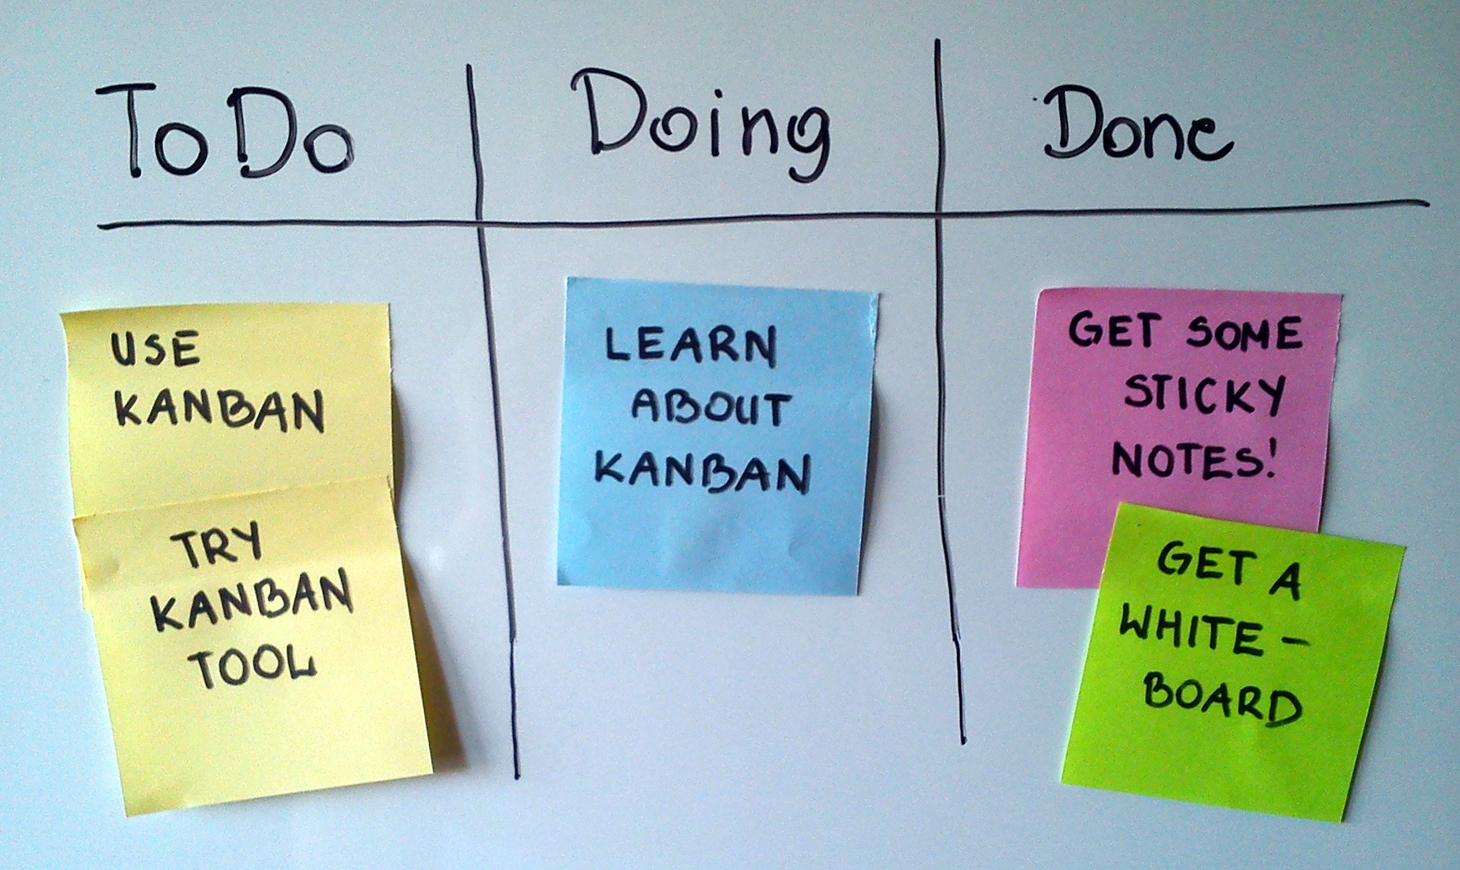
Notes:
An English-language term that captures the meaning of the Japanese word, Kanban (看板), is queue limiter; and the beneficial result is queue limitation. In other words, we should limit the number of tasks that we can have in the “In Progress” list.

Slide 21
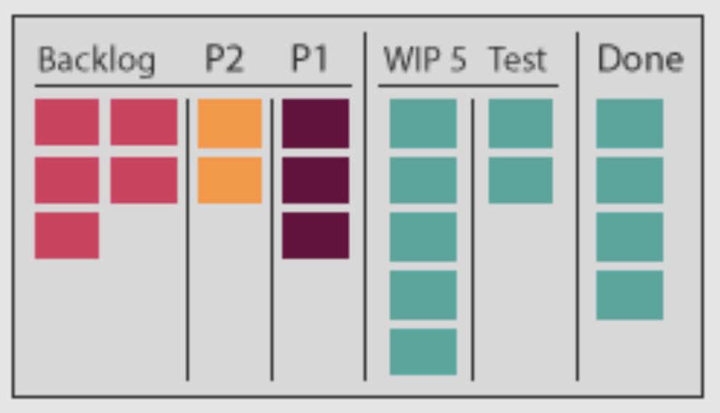
M O N T H L Y G L O B A L
KANBAN Board Elements
Backlog:
A comprehensive and unfiltered list of tasks to be done
Priorities:
Separating tasks into different priorities (P1, P2)
Test:
Validation of tasks before considering them done
Icebox:
A wish-list bucket of ideas to do in the future

Slide 22
Finish the most important task first, then focus on the second most important task.
REPEAT.

Slide 23
M O N T H L Y G L O B A L
Definition of Done DoD
Purpose: Ensures everyone knows exactly what is expected and deliver accordingly.
It’s a list of activities attached to every task in the Kanban Board.
It ensures transparency and quality fit for the purpose of the product and organization.
Takeaway: focusing on value help identify and eliminate wasteful activities that only complicate the team’s efforts.
Verifying that your team’s DoD meets the criteria will ensure that you are delivering features that are truly done, not only in terms of functionality but in terms of quality as well.

Slide 24
IRONHACK BOOTCAMP
Definition of Done DoD
Checklist of valuable activities required to produce software/designs
DoD is the primary reporting mechanism for team members
DoD is informed by reality
DoD is not static, it is an auditable checklist

Slide 25
Kanban Tools

Slide 26

Notes:
Trello is a free tool you can use to create a Kanban board and manage all project tasks and features. It offers a visual board where you can create cards and drag and drop them through the different statuses they can have.

Slide 27


